Slide 1
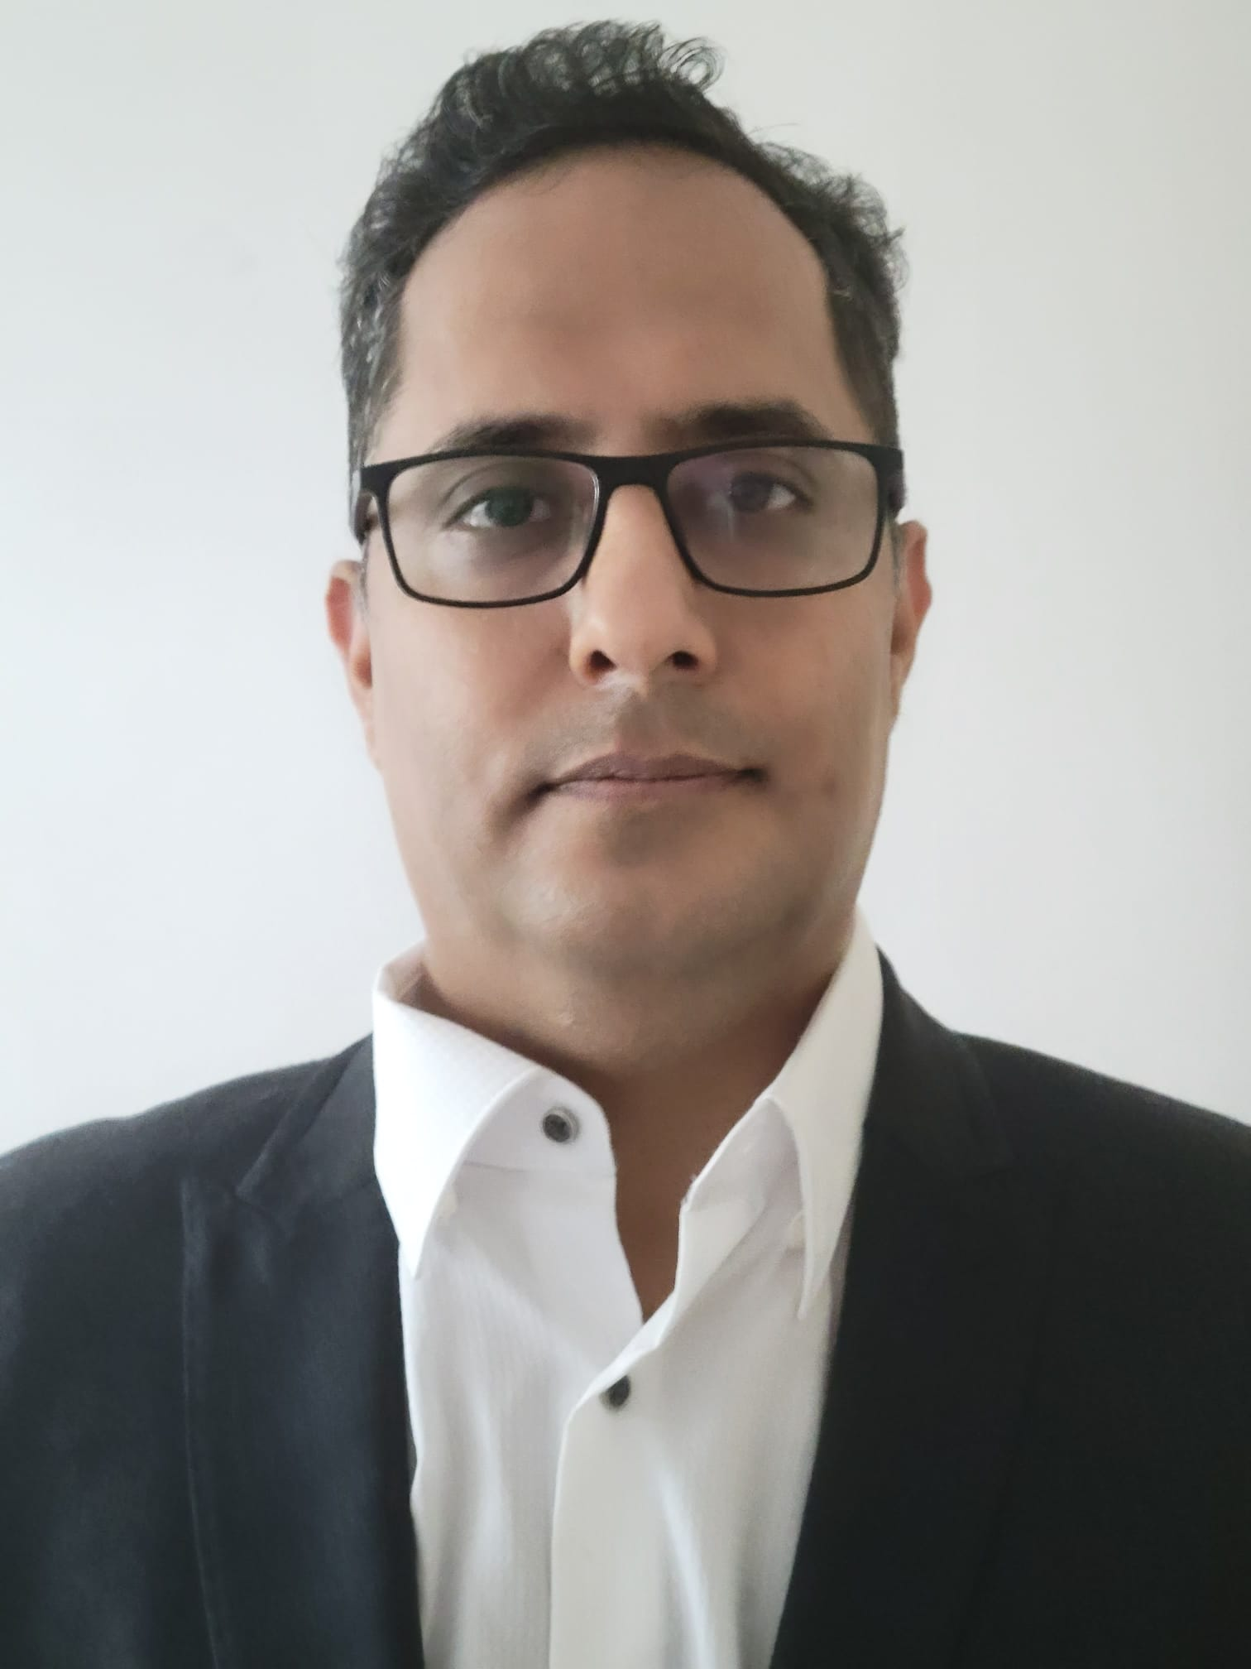
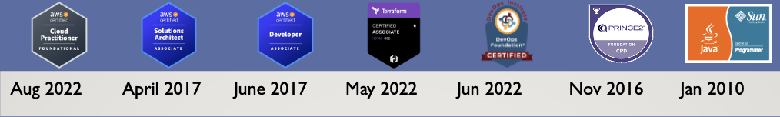
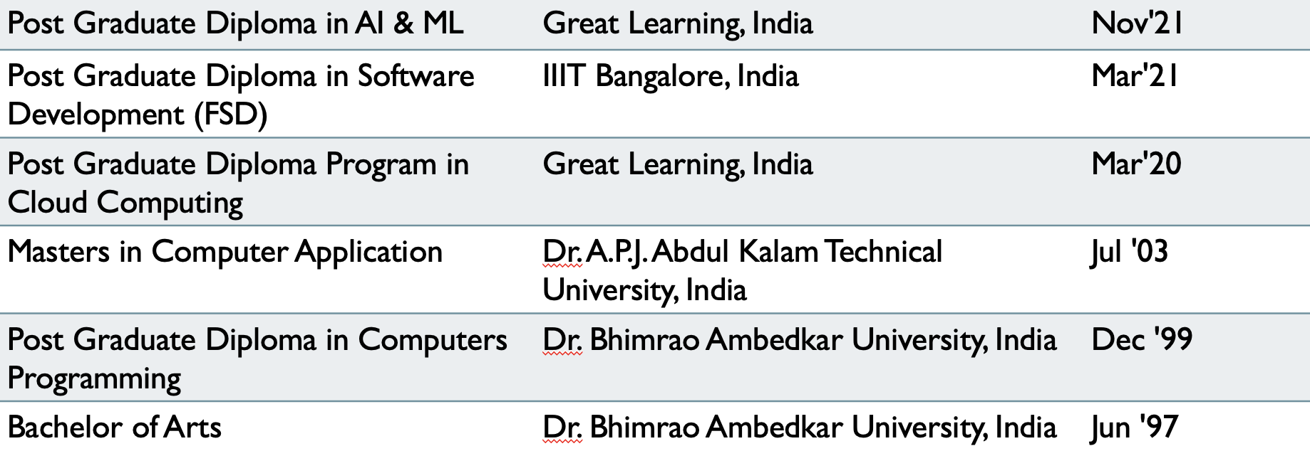
Mayank Chugh
Senior Technical Manager (Cloud + Application)
Email: mayankchugh.jobathk@gmail.com
Mobile: +852 84812040
LinkedIn: www.linkedin.com/in/mchugh44
Git: https://github.com/mayankchugh1977
Summary
Relevant Experience
Hands-on solution-driven IT professional with 18+ years of extensive experience as a consultant, solution architect, Security Designs, project manager, team lead, and senior engineer for multiple software development projects. Focus on pre-sales, product scoping & pricing, solution development, project management, release management, network engineering, and systems administration. Energetic and recognized for having excellent communication and problem-solving skills spanning multiple technical towers and global enterprises.
Client: CHANEL
Participated in Pre-sales activity for providing High availability, Fault tolerant and resilience application to the client.
Contributing as SME for application implementation and Azure cloud for accepted SLA, RPO and RTO.
Working closely with delivery head, fellow Architects and other members for delivering complete IT solutions.
Client: HSBC
Gathered project requirements for setting up application on Cloud through interactions, meetings, and walkthroughs with potential application users functional and non-functional requirements.
Server side API designing, Security Patterns designs decision and Providing AWS architecture for setting up AWS EKS cluster having Jenkins CI/CD pipeline.
Client: Cathay Pacific Cargo Terminal & Asia Airfreight Terminal
Gathered project requirements (150+ of AAT and 35+ of CPSL) through interactions, meetings, and walkthroughs with potential application users and develop business requirements documents (BRD), functional requirements documents (FRD), and user mock-ups. Also, I created 55+ technical responses to Requests for Quotes (RFQs) for customers.
I Provided winning solutions as part of the pre-sales team, which included responding to RFPs and RFIs from existing and prospective clients. Recently, involved in a proposal for the migration of Monolithic to cloud study. Conducted a few POCs for the same Participated in both pre-sales and post-sales activities, including establishing statements of work, responsibility matrixes, and overseeing the technical realization of solutions by delivery teams.
Worked closely with executive sales teams to deliver quotes and full IT solutions in networking, computing, storage, and virtual cloud infrastructure. Also, Designed and developed projects: On-premise Storage move to AWS, OCR using AI Computer vision, AWS IOT using MQTT (pub/sub) for controlling Cold Box for warehouse cargo application.
Monitor SLA and tested application performance to identify potential bottlenecks, develop solutions, and collaborate with developers on solution implementation for 5 Web, 3 Mobile applications. Provided 2nd and 3rd level technical support and troubleshooting to internal and external clients. Team Size - 4 - on-site resources, 4 - offshore resources.
Successfully managed multimillion-dollar revenue accounts including focus on several Completed 15.5K days of works. I have managing releases during all phases of software development life cycle, from requirements analysis through system implementation for more than 2 enterprises projects. Worked closely with customers, internal staff and other stakeholders to determine planning, implementation and integration of system-oriented projects. System development of RESTful API for having interface with HKIA.
Skills
Project lifecycle management; Project manager supervision; Release management; Technical project planning; Project requirements analysis; Build technical teams; Technical documentation understanding; Solution Technical architecture (Application + Cloud); Security Designs/Patterns; Project scheduling and budgeting; Custom software development and database design; System migration/integration; Quality assurance
Cloud Services: AWS EC2, ELB, EBS, S3, VPC, SES, SNS, IAM, RDS, Cloud Watch, Cloud Front, AWS CLI, AWS IOT MQTT (pub/sub);DevOps: GIT, Jenkins pipeline, AWS CI/CD pipeline, dockers, Ansible, AWS ECS, EKS cluster, K8S, Terraform; Languages: Java / J2EE, EJB, Spring Boot, JavaScript, ReactJS, Struts 1.x MVC, PL/SQL, Python; Databases: Oracle, MySql, Postgres; Reporting: iReport, Jasper Report;; Version Control: GIT, SVN, VSS; Web Services: Soap, Rest API Development, Swagger API; Management Tool: JIRA, Maximo, Confluence; Bugzilla, Mantis; Machine Learning: Supervised Learning – Linear/Logistic Regression, Decision Tree, Random Forrest Tree; Operating Systems: Windows (XP, 10), Lunix and Ubuntu; Methodologies: Agile, Iterative, Waterfall Model
Education

